Slide 1
Bioethics in Anatomy Education Resources:
Basic Introduction to Bioethics
Description:
This set of PowerPoint slides provides basic information on the fundamentals of ethical decision making. It can serve as a short primer on the role of ethics in healthcare. The first slide provides the four major ethical fundamentals while additional slides provide the history of ethics in health care and some general examples of ethical decision making.
The topics covered by this resource include:
Ethical fundamentals
History of ethics in healthcare
Creator(s): Thomas Champney
Contact details: tchampney@med.miami.edu
Further reading:
Campbell, CS. Mortal Responsibilities: Bioethics and Medical-Assisted Dying. Yale J Biol Med 92(4):733-739, 2019.
Notini L, Vasileva D, Orchanian-Cheff A, Buchman DZ. Ethical issues associated with solid organ transplantation and substance use: a scoping review. Monash Bioeth Rev 37:111-135, 2019.

Slide 2
Bioethical Fundamentals
There are four pillars of bioethical decision making in healthcare. These are:
1. Autonomy – the ability to make your own decisions. The patient has the right
to determine what can or cannot happen during treatment by making an
informed, uncoerced decision (consent).
2. Beneficence – an act of charity or kindness. A healthcare professional must
act for the benefit of the patient with no other motives.
3. Nonmaleficence – “do no harm”. A healthcare professional must not harm
the patient.
4. Justice – providing fairness in healthcare decisions. A healthcare professional
must treat all individuals equally with an equitable distribution of resources.
https://www.themedicportal.com/blog/medical-ethics-explained-justice/
https://vtethicsnetwork.org/medical-ethics
Notes:
2

Slide 3
Short History of Ethics in Healthcare
Since the era of Hippocrates (460 – 370 BC), the proper, ethical treatment of patients by healthcare providers has been emphasized. The hippocratic oath and other more modern versions have all stated how to appropriately treat patients.
More recently, four pillars of bioethical decision making in healthcare have been developed: autonomy, beneficence, nonmaleficence and justice. Each of these must be taken into consideration when treating patients.
Most hospitals have ethics review boards that use these pillars to determine the proper and appropriate treatments for patients in difficult and ethically challenging situations. These boards provide guidance to healthcare providers, the patients and their families facing these unique circumstances.
https://medschool.ucla.edu/body.cfm?id=1158&action=detail&ref=1056
https://vtethicsnetwork.org/medical-ethics
https://www.ama-assn.org/delivering-care/ethics/ethics-committees-health-care-institutions
Notes:
3

Slide 4
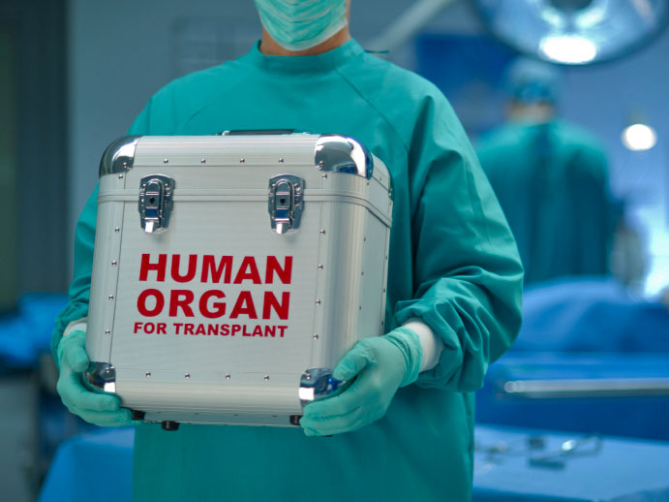
Example of Ethical Decision Making in Healthcare
One example of ethical decision making in healthcare is managing the inadequate supply of donor organs that are needed for transplant. Societies that develop the guidelines for the use of donor organs must take into consideration all four pillars of bioethical decision making.
Some societies decide on an “opt in” response which requires all donors to specifically choose to donate their organs while other societies decide on an “opt out” response which states that the organs of the deceased will be available for transplant unless the donor specifically opts out.
Notice how these two responses provide more weight to autonomy (“opt in”) versus beneficence and justice (“opt out”). These are bioethical decisions that must be discussed and agreed upon by all those involved in the process.
https://archive.hshsl.umaryland.edu/bitstream/handle/10713/6488/Tarzian%20Talk%20110116.pdf
https://catholicmoraltheology.com/on-the-ethics-of-organ-transplantation-a-catholic-perspective-part-i/
Notes:
4

